Slide 1


Slide 2
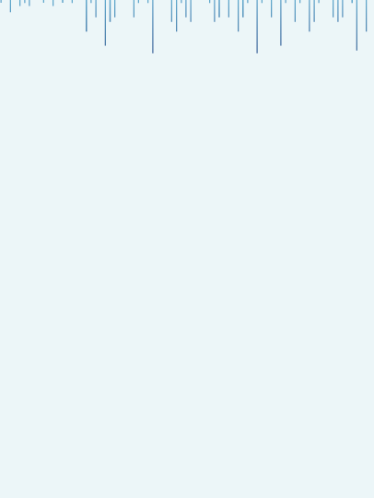


Predicting Solar Energy Production
Maximizing Solar Energy Production
with Machine Learning
Presented by : Pushpak Shrimal

Slide 3
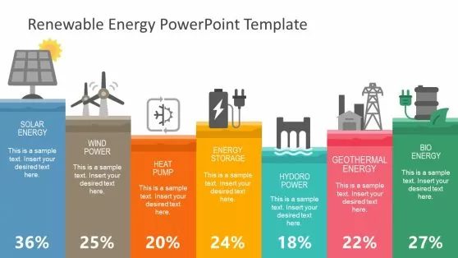
Introduction
Solar innovation progresses in both subtle and groundbreaking ways. From solar panels decorated with nanowires
to windows that magically convert light into electricity.
The breadth of developments is both wide and promising.
The electricity supplied by photovoltaic (PV) modules varies greatly
according on weather conditions.
PV panels generate direct current (DC), which must be converted to
alternating current (AC) before being fed into the grid, used locally,
and transmitted to the point of consumption.
Machine learning, with its predictive powers, provides an examination
of the developers, equipment, and location of solar energy output.
This talk will highlight my Machine Learning Capstone Project, Predicting Solar Energy Production,
using data-driven insights and predictive modeling.

Slide 4
Project’s Benefits to Solar Energy Provider
Demand Forecasting: Increased accuracy in estimating the balance between supply and demand enables more cost-effective operation
Increased Revenue: Accurate production forecasts enable providers to sell surplus energy at optimal times, increasing revenue.
Long-term Planning: Predictive models support long-term strategic planning, including expansion, resource allocation, and market positioning.
Innovation Drive: Encourages continuous improvement and innovation in predictive analytics, machine learning, and solar technology.
Corporate Responsibility: Enhances the provider’s reputation as a responsible and forward-thinking company committed to environmental stewardship.

Slide 5
Why Solar Energy ?
The selection of the solar energy domain is based on a number of strong factors, including its importance for
sustainable development, financial gains, scientific breakthroughs, and environmental effects.
For my capstone project, I decided on the solar energy domain because: Sustainable Energy Source: Solar energy is a plentiful and endless resource that can be used to meet the world's energy demands in the long run, unlike finite fossil fuels. Cost-Effectiveness: As solar panels and related technologies have become more inexpensive, solar energy has been more accessible. Energy Supply Diversification: Solar energy improves national energy security and independence by lowering dependency on foreign fuels. Research and Innovation: The solar energy industry is a major driver of technical advancement in electronics, materials science, and energy storage technologies. Predictive analytics: The development of precise models for forecasting solar energy output and improving its integration into the energy grid is made feasible by developments in data science and machine learning.

Slide 6
Why Solar Energy ?
The selection of the solar energy domain is based on a number of strong factors, including its importance for
sustainable development, financial gains, scientific breakthroughs, and environmental effects.
For my capstone project, I decided on the solar energy domain because: Sustainable Energy Source: Solar energy is a plentiful and endless resource that can be used to meet the world's energy demands in the long run, unlike finite fossil fuels. Cost-Effectiveness: As solar panels and related technologies have become more inexpensive, solar energy has been more accessible. Energy Supply Diversification: Solar energy improves national energy security and independence by lowering dependency on foreign fuels. Research and Innovation: The solar energy industry is a major driver of technical advancement in electronics, materials science, and energy storage technologies. Predictive analytics: The development of precise models for forecasting solar energy output and improving its integration into the energy grid is made feasible by developments in data science and machine learning.

Slide 7

PROBLEM STATEMENT
This dataset was developed to anticipate solar energy generation in order to help business growth.
This capstone project aims to create a prediction model capable of precisely estimating solar energy production.
By using this procedure, the business hopes to educate clients so they may choose
developers, locations, and equipment wisely, improving project planning
and maximizing return on investment.

Slide 8

Dataset Information
Column Name
Data Through Date
Project ID
Interconnection Date
Utility
City/Town
County
Zip
Division
Substation
Circuit ID
Developer
Metering Method
Estimated PV System Size
PV System Size
Estimated Annual PV Energy Production
Energy Storage Size System
Number of Project
Here are the key details about the dataset used in this project:
Number of records: Our dataset comprises a robust collection of data, consisting of 2,18,115 records. Each record represents a unique entry, contributing to the richness and depth of our analysis.
Features/Columns: The dataset is characterized by a diverse set of features, each providing valuable insights into developer, pv system size, and annual pv energy production. In total, there are 17 features/columns that form the basis of our predictive modeling.
Source of the Data: The dataset is sourced from LMS, ensuring reliability and relevance. The data's origin plays a crucial role in shaping the context and ensuring that our analysis is grounded in real-world scenarios and industry dynamics.

Slide 9
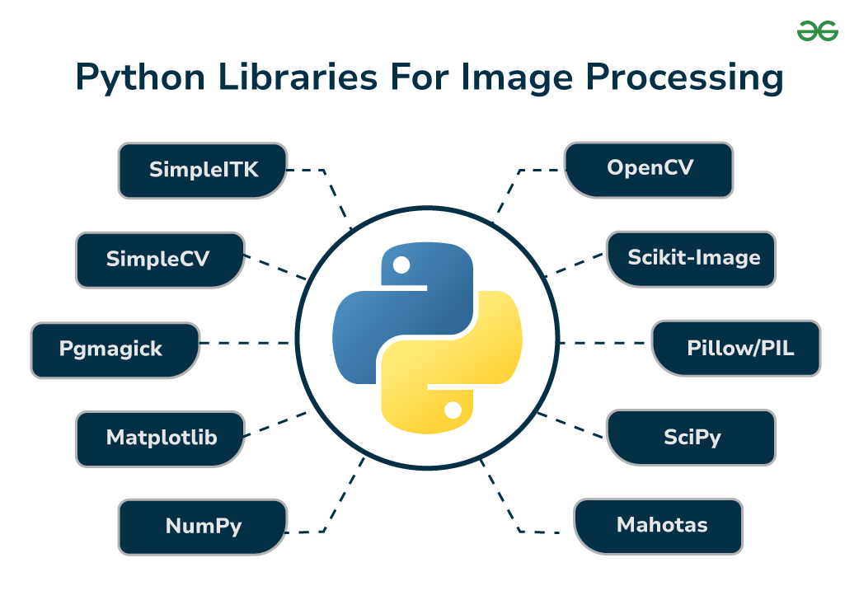
Libraries Imported
# Importing 'Pandas’
import pandas as pd
# Importing 'Numpy'
import numpy as np
# Importing 'Matplotlib'
import matplotlib as plt
import matplotlib.pyplot as plt
# Importing 'Seaborn'
import seaborn as sns
# To supress warnings
import warnings
warnings.filterwarnings('ignore’)
import random

Slide 10
Libraries Imported
from sklearn.model_selection import train_test_split
from sklearn.preprocessing import LabelEncoder
from sklearn.metrics import mean_absolute_error, mean_squared_error, r2_score
from sklearn.model_selection import GridSearchCV
from sklearn.linear_model import LinearRegression
from sklearn.tree import DecisionTreeRegressor
from sklearn.neighbors import KNeighborsRegressor
from sklearn.ensemble import GradientBoostingRegressor
from sklearn.ensemble import RandomForestRegressor

Slide 11

Exploratory Data Analysis (EDA)
Data exploration allowed us to gain a comprehensive grasp of the
structure of the data.
It gave us vital dataset insights, helped us spot significant trends, and exposed
potential patterns.
We looked at relationships and the distribution of the individual traits. and
during the EDA process examined any inherent relationships between variables.
Visualizations also enabled a clear representation of the data, offering
detail son the distribution of equipment sizes and the solar energy
generated by particular developers.

Slide 12
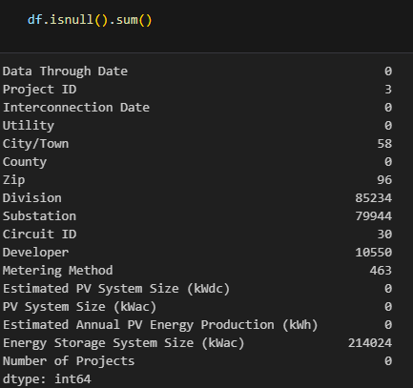
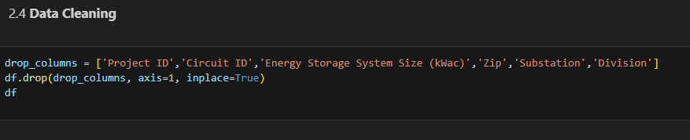
Exploratory Data Analysis (EDA)
Null Values
Dropping Columns
Importing Random Values

Slide 13

Exploratory Data Analysis (EDA)
Since there were a lot of null values in my dataset, I started by finding the NULL VALUES and filling them in at random. After imputing missing or null values to the dataset, my data was clean enough to move further with EDA.
Next, we looked at our columns to see if they were giving us any information that might be helpful. It was discovered that the columns labeled "Project ID," "Zip," "Circuit ID," "Division," "Substation," and "Energy Storage System Size" were not significantly influencing the forecasts. I thus made the decision to exclude them from the preprocessing.
In our dataset, the categories Developer, County, Utility, Metering Method,
and City/Town were present. These category attributes needed to be
converted into a numerical representation in order for them to function
with our model.

Slide 14
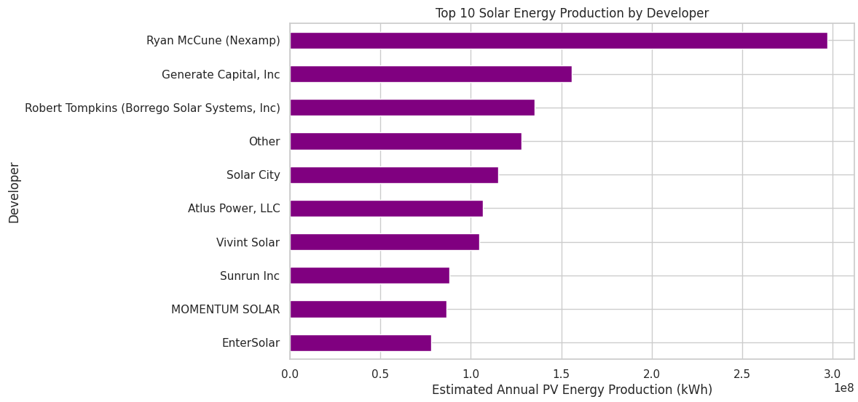
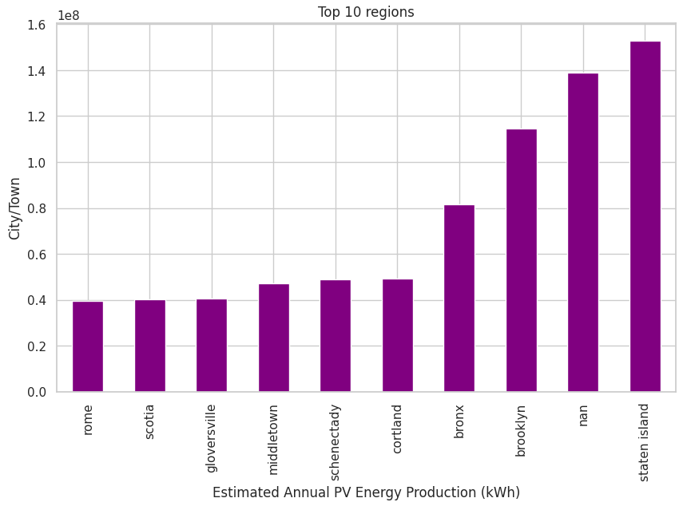
Visualizations
The goal variable, "Estimated Annual PV Energy System," displays the production level of each developer in the figure above.
The yearly solar energy production by location is shown in the above graphic. Staten Island is where the greater solar energy generation takes place.

Slide 15
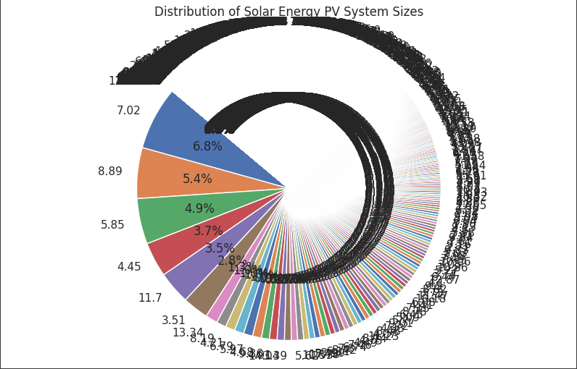
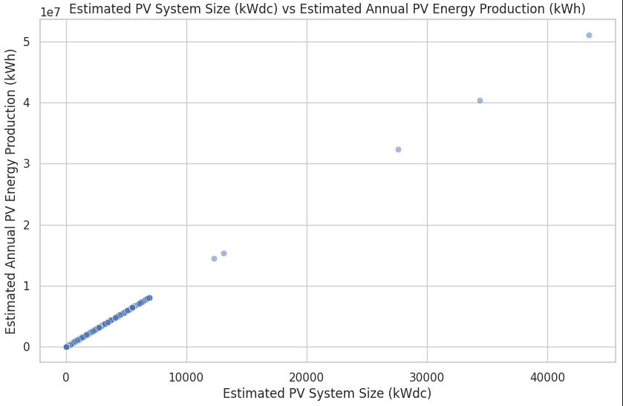
Visualizations
The accompanying graphic depicts the production level of each PV System Size.
The accompanying graphic depicts the Estimated PV System Size (kWdc) vs Estimated Annual PV Energy Production (kWh
of each PV System Size.

Slide 16
Splitting the data into X and y
In this step, we partitioned the dataset into two components: X and y.
The variable X encompasses all independent variables, representing the features that contribute to our predictions.
On the other hand, y encapsulates the dependent variable or target variable, serving as the outcome we aim to predict.
Train-Test Split
Next, we divided the dataset into test and training sets.
We split our data 80:20, which means that 80% of it is training data and the remaining 20% is testing data. Thus, we used a test size of 0.2.
For Random State, we used 42. This ensured that our results would be consistent between runs.
To make sure that our Target Variable (y) is spread proportionately, we additionally used Stratify = y.

Slide 17
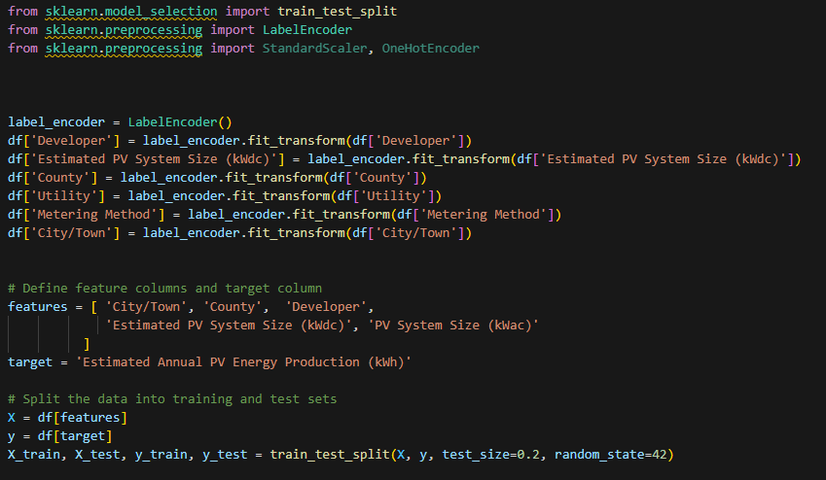
LABEL ENCODING
TRAINING THE DATA INTO TRAIN TEST SPLIT

Slide 18
Machine Learning Algorithms
This Solar Energy Production challenge is one of multiclass classification.
Models used:
Linear Regression : Linear regression is a statistical technique for modeling and predicting the connection between a dependent variable and one or more independent variables by fitting a linear equation to observed data. The purpose is to determine which linear equation best describes the variance in the dependent variable as a function of the independent variables.
DecisionTreeRegressor : Decision trees use a tree structure to construct models for classification or regression. It partitions a dataset into progressively smaller subgroups and simultaneously builds a corresponding decision tree piecemeal. A tree containing decision nodes and leaf nodes is the end product.
KN-Neighbour Regressor : A machine learning technique called the KN-Neighbour Regressor is used for regression problems. It predicts a target variable's value by averaging, or weighting, the target values of the k nearest neighbors in the future space.
GradientBoostingRegressor : This estimator permits the optimization of any differentiable loss functions and constructs an additive model in a forward, step-by-step manner. Every step involves fitting a regression tree on the loss function's negative gradient.
Random Forest Regressor : Random Forest Regressor: Designed for regression problems, a Random Forest Regressor is an ensemble learning technique that generates numerous decision trees during training and outputs the mean of them in order to reduce overfitting and increase accuracy.

Slide 19

Evaluation Metrics
Without Grid Search CV
With Grid Search CV
Model | MSE | R2 | MAE
LR | 13301528.726 | 0.9998 | 1114.565
DTR | 6782297325.317 | 0.9375 | 437.704
KNN | 1106199110.896 | 0.9898 | 772.876
GBR | 382913553.564 | 0.9964 | 295.807
RF | 866593220.391 | 0.9920 | 167.361
Model | MSE | R2 | MAE
LR | 13301528.726 | 0.9998 | 1114.565
DTR | 6785647785.872 | 0.9375 | 1655.802
KNN | 482392207.725 | 0.9955 | 602.992
GBR | 194326010.965 | 0.9982 | 228.304
RF | 394794286.316 | 0.9963 | 186.833
We can see that GridSearch CV makes a difference.
Following GridSearch CV, the R2 is the same in the LR and DTR models but increases in the KNN, GBR, and RF models. The Mean Absolute Error is lowered in the KNN and GBR models and raised in the DTR and RF models. The Mean Squared Error is likewise increased in the DTR models but dropped in the KNN, GBR, and RF models.

Slide 20
Model Selection and Considerations
When GridSearchCV is used or not, linear regression performs similarly and does not alter any of the metrics but perform best in MSE and R-squared value.
The Random Forest model performed the best based on the Mean Absolute Error (MAE) and Mean Squared Error (MSE) metrics. It achieved the lowest MAE of 186.83 and the second lowest MSE of 394,794,286.32, with a high R-squared value of 0.99637, indicating that it captures the variance in the data very well
The numbers that are presented clearly show that RF is the model with the highest overall performance. Its low error and good MAE/R2 balance make it appropriate for our solar energy forecast challenge.
Metrics like MAE and R2 are important, but MSE is especially important for solar energy prediction as it shows how well the output of solar energy can be predicted. Additionally, the Random Forest Regressor gave us the optimal MAE value.
Since it is clear that the Random Forest Regressor performs best for our Solar Energy Prediction issue, we will use it as our final model.

Slide 21
Conclusion
Predicting Solar Energy Production is the focus of this machine learning classification for the customer, a well-known renewable energy supplier committed to growing their solar energy portfolio while maintaining effective grid connectivity.
In order to facilitate their growth, I have created a model that precisely projects the yearly output of solar energy for upcoming installations, taking into account factors like equipment, developer, and location.
The developer entitled “Nexamp" and " Generate Capital Inc " are the top producers of solar energy, according to the study above.
Higher zonal cities like "Staten Island," "nan," and "Brooklyn" have significant sun energy production.
The two most produced PV system sizes are 7.02 (KWdc) and 8.89 (KWdc).

Slide 22

Thank You !

